Slide 1
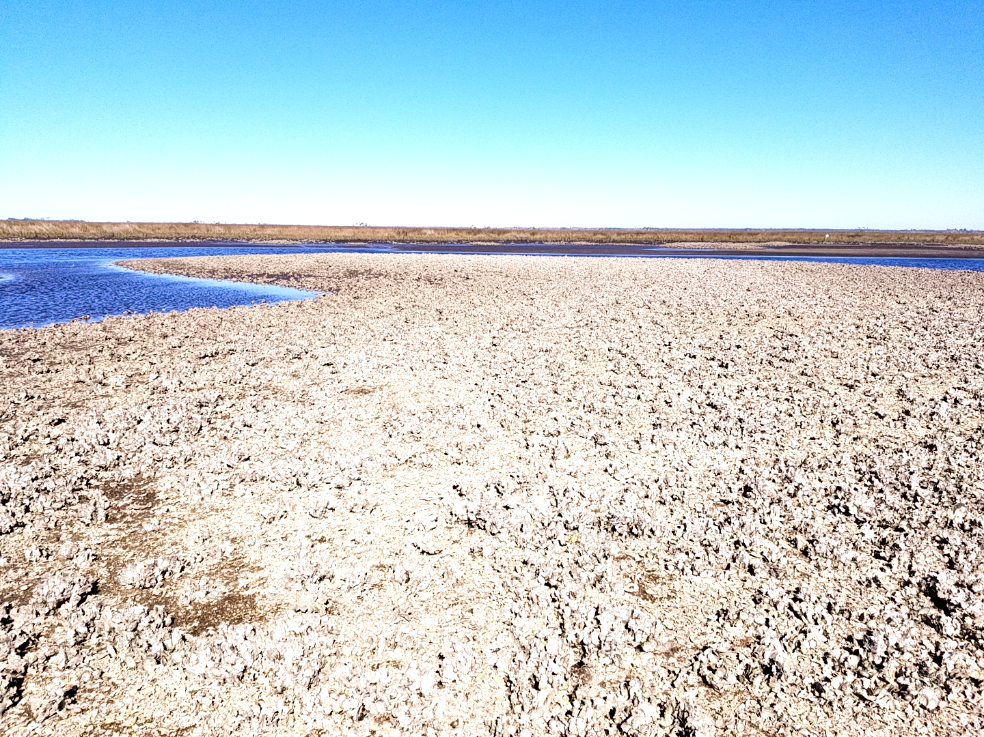




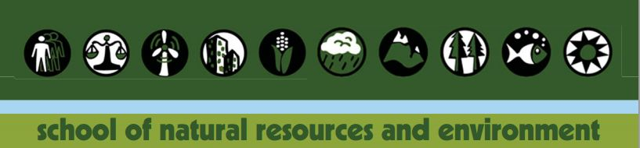
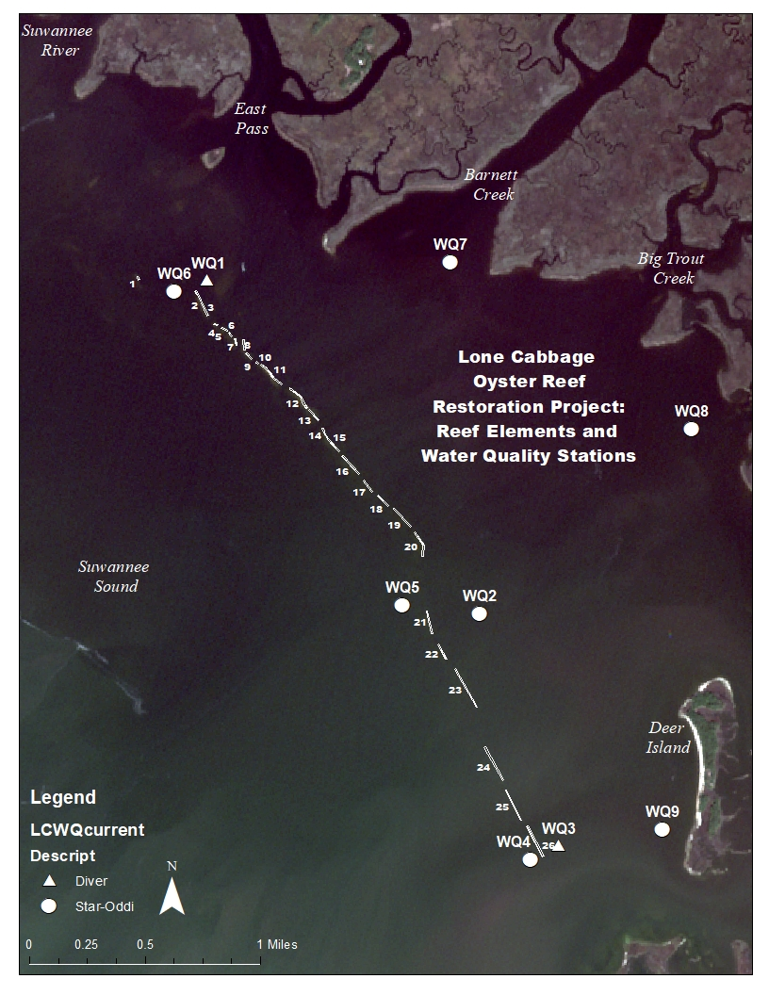
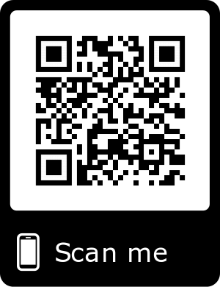
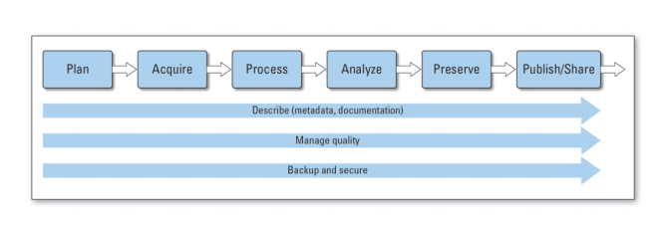
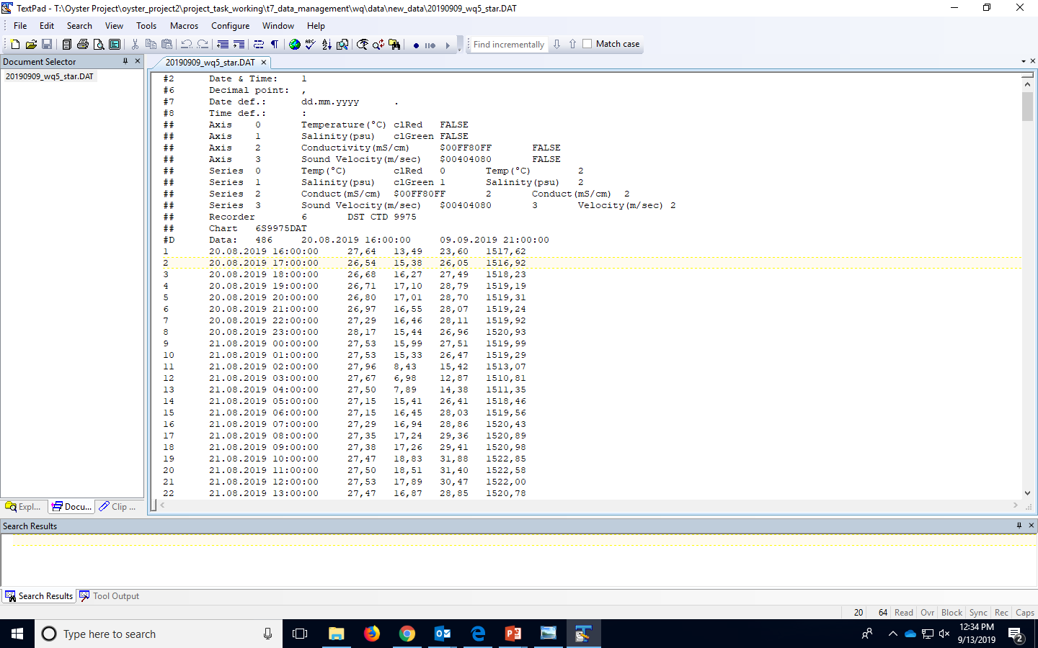


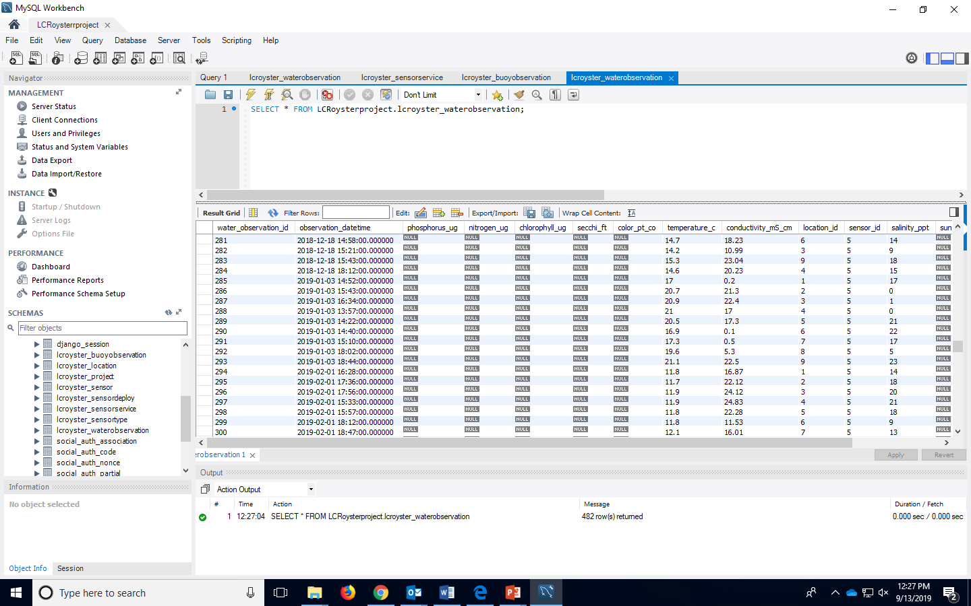
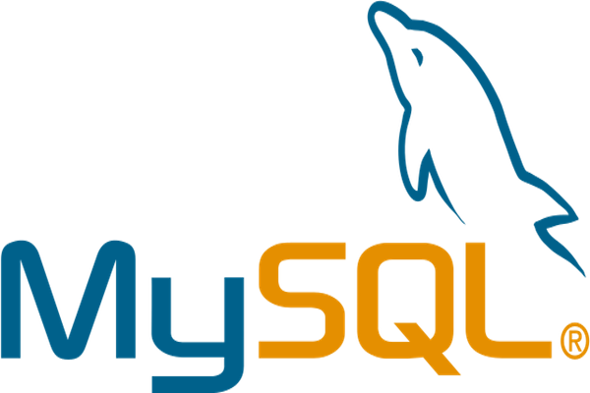

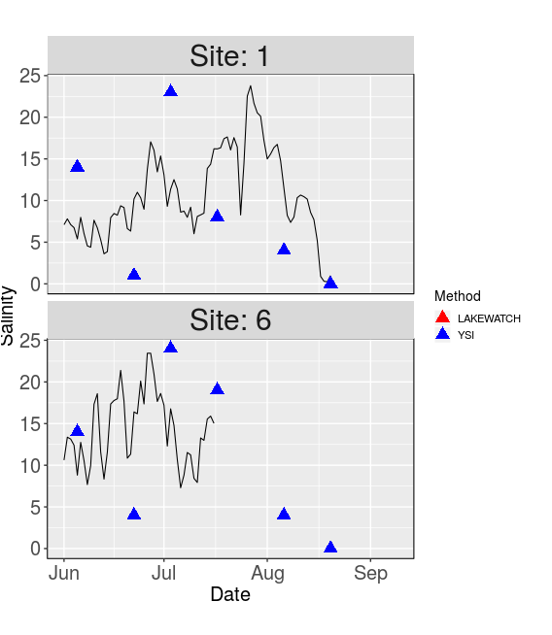
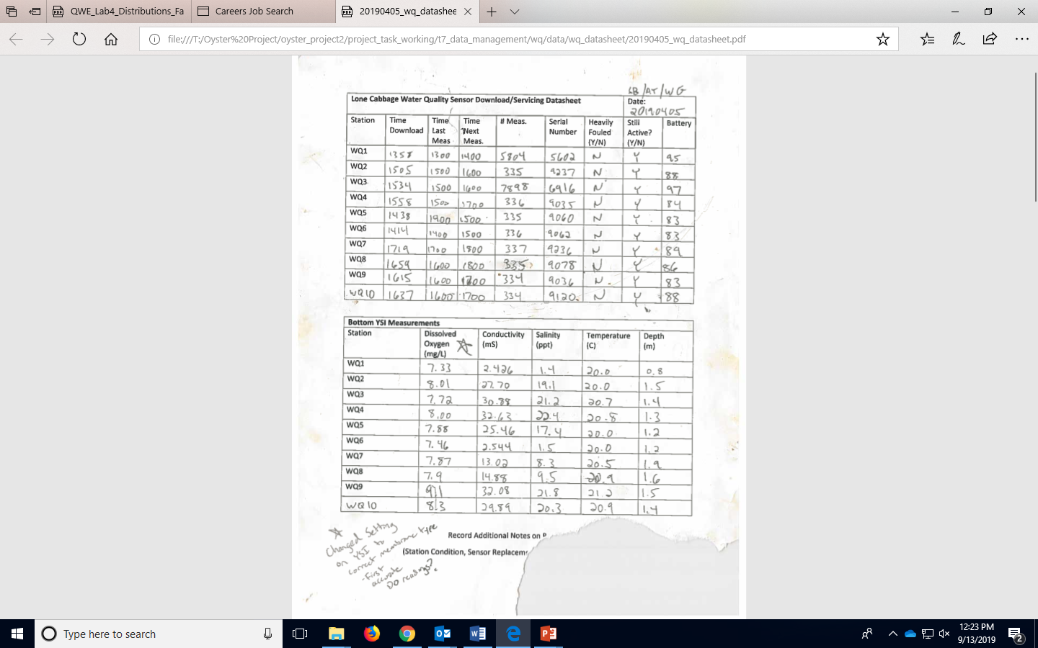

Big Changes in the Big Bend:
A Data Management Story
Introduction
Methodology
Interactive Shiny App
The Lone Cabbage Reef (LCR) restoration project is NFWF funded to restore the LCR oyster reef to historic oyster count levels by reconstructing and elevating the existing reef. Oysters counts, oyster length measurements, water quality observations all need to be collected to observe changes pre- and post- reconstruction. These data are considered to be “living data”.
“Living data” are defined as data which are continuously collected and added to existing collected data. Living data are challenging with from a data management perspective because the data (by design) continuously change as new data are collected.
The Methodology behind our project’s workflow is designed based on the USGS Data Management Guidelines. All aspects of the workflow need to be planned prior to data collection. The Guidelines include:
Plan- Planning on what data will be collected and how to manage it
Acquire- How data will be collected and how that process will be standardized
Process- How data will be processed, QA/ QC procedures
Analyze- What analysis needs to be performed on data?
Preserve- A plan for storing and preserving data
Publish/Share- A plan for making data available in a standardized format for publishing and sharing
After water quality data are imported, data are processed to update an interactive Shiny App. This app is available to the public and can be found on the QR code. All data and code are online and available on Github. The Shiny App complies with the Publish/Share component of the USGS Data Management Guidelines.
Since data are stored in the MySQL database, they
accessible at any time (by approved
team members) and are not changed within the
database. All raw imported data are stored and kept
with their original observation values.
Data manipulation occurs in R in a safe
environment where the original data is not affected.
Manipulation can include removing data
that could be considered tampered with or sub-setting
data for specific sites.
Figure1- Map of Lone Cabbage Reef and sensor locations
Figure 3- USGS Data Management Guidelines (https://www.usgs.gov/products/data-and-tools/data-management)
Figure 2- Screen shot of Star-Oddi sensor continuous raw collected data in a .DAT file
Figure 4- Screen shot of MySQL database including the water quality continuous measurements (imported) and discrete measurements (manually entered)
QA/QC DURING DATA ENTRY:
Paper data sheets to electronic records
The process of transferring data from paper datasheets to electronic form is a common source of potential errors. Double data entry and added QA/QC procedures help ensure data integrity.
Transfer electronic records from sensor to database
When individually collected sensor data files are transported back to the lab these files must be checked for errors and the data amended to an existing database to provide a continuous record of the water quality observations of interest. In our project this is done by:
Step 1. Automated data import using custom Python code for initial QA/QC and storing in mySQL database for storage.
Step 2. Create a series of checks to ensure data integrity, using data analysis software (i.e R, python).
Step 3. Create visualizations and summary tables, , using data analysis software (i.e R).
Figure 5- Screen shot of Shiny App displaying the continuous and discrete water quality data (salinity) for Sites 1 and 6
Future Data Work
Future data work includes creating a custom R package for the LCR project, which will create tables and figures simply and quickly. Having the custom package will save time and automate creating figures for reports and publications.
Acknowledgments:
Dan Maxwell - Associate University Librarian at the University of Florida
Plato Smith - Data Management Librarian at the University of Florida
Robert Phillips - Information Technologist, George A. Smathers Libraries at the University of Florida
Peter Fredrick - Research Professor in the Department of Wildlife Ecology and Conservation at the University of Florida
Steve Beck - Research Coordinator for Lone Cabbage Reef Restoration Project at the University of Florida
Sarah Meyer - Health Sciences Librarian at the University of Florida
Figure 2- Screen shot of field data sheet collecting times of downloads and YSI water quality discrete measurements

